Slide 1
Handling Constraints

Slide 2

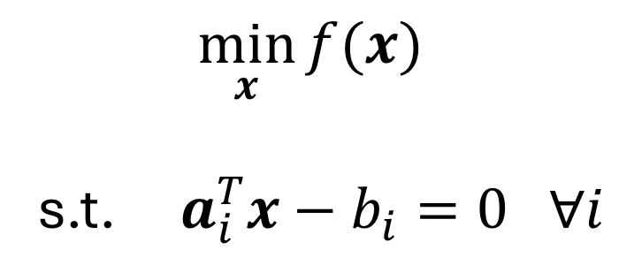
Handling Equality Constraints
$$\min_{x}{f(x)}$$
s.t. $a_{i}^{T}x−b_{i}=0 ∀i$

Slide 3
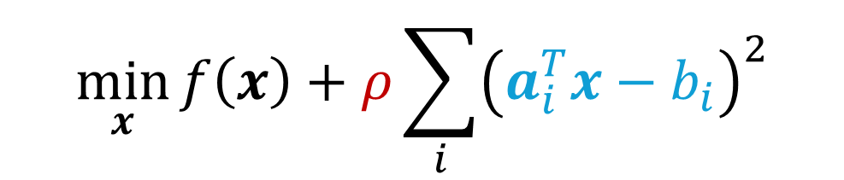
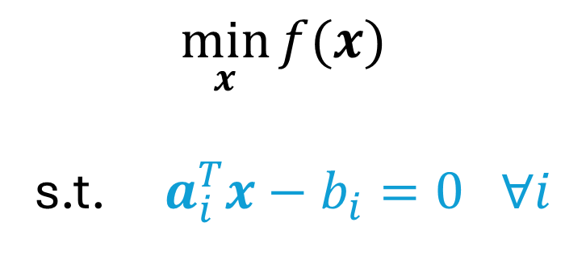
Handling Equality Constraints
Penalty
$$\min_{x}{f\left(x\right)+ρ\sum_{i}^{ }{{\left(a_{i}^{T}x−b_{i}\right)}^{2}}}$$
$$\min_{x}{f(x)}$$
s.t. $a_{i}^{T}x−b_{i}=0 ∀i$

Slide 4
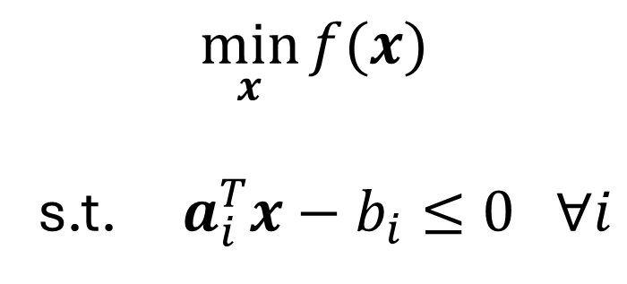
Handling Inequality Constraints
$$\min_{x}{f(x)}$$
s.t. $a_{i}^{T}x−b_{i}≤0 ∀i$

Slide 5
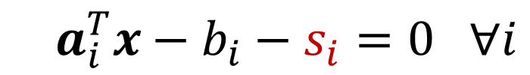
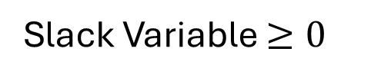
Handling Inequality Constraints
$$\min_{x}{f(x)}$$
s.t. $a_{i}^{T}x−b_{i}≤0 ∀i$
Convert to equality
$a_{i}^{T}x−b_{i}−s_{i}=0 ∀i$
Slack Variable $≥0$

Slide 6

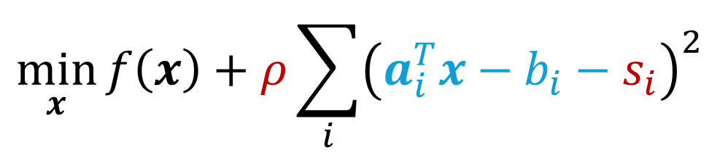
Handling Inequality Constraints
$$\min_{x}{f(x)}$$
s.t. $a_{i}^{T}x−b_{i}≤0 ∀i$
Penalty
$$\min_{x}{f\left(x\right)+ρ\sum_{i}^{ }{{\left(a_{i}^{T}x−b_{i}−s_{i}\right)}^{2}}}$$
Convert to equality
$a_{i}^{T}x−b_{i}−s_{i}=0 ∀i$
Slack Variable $≥0$

Slide 7
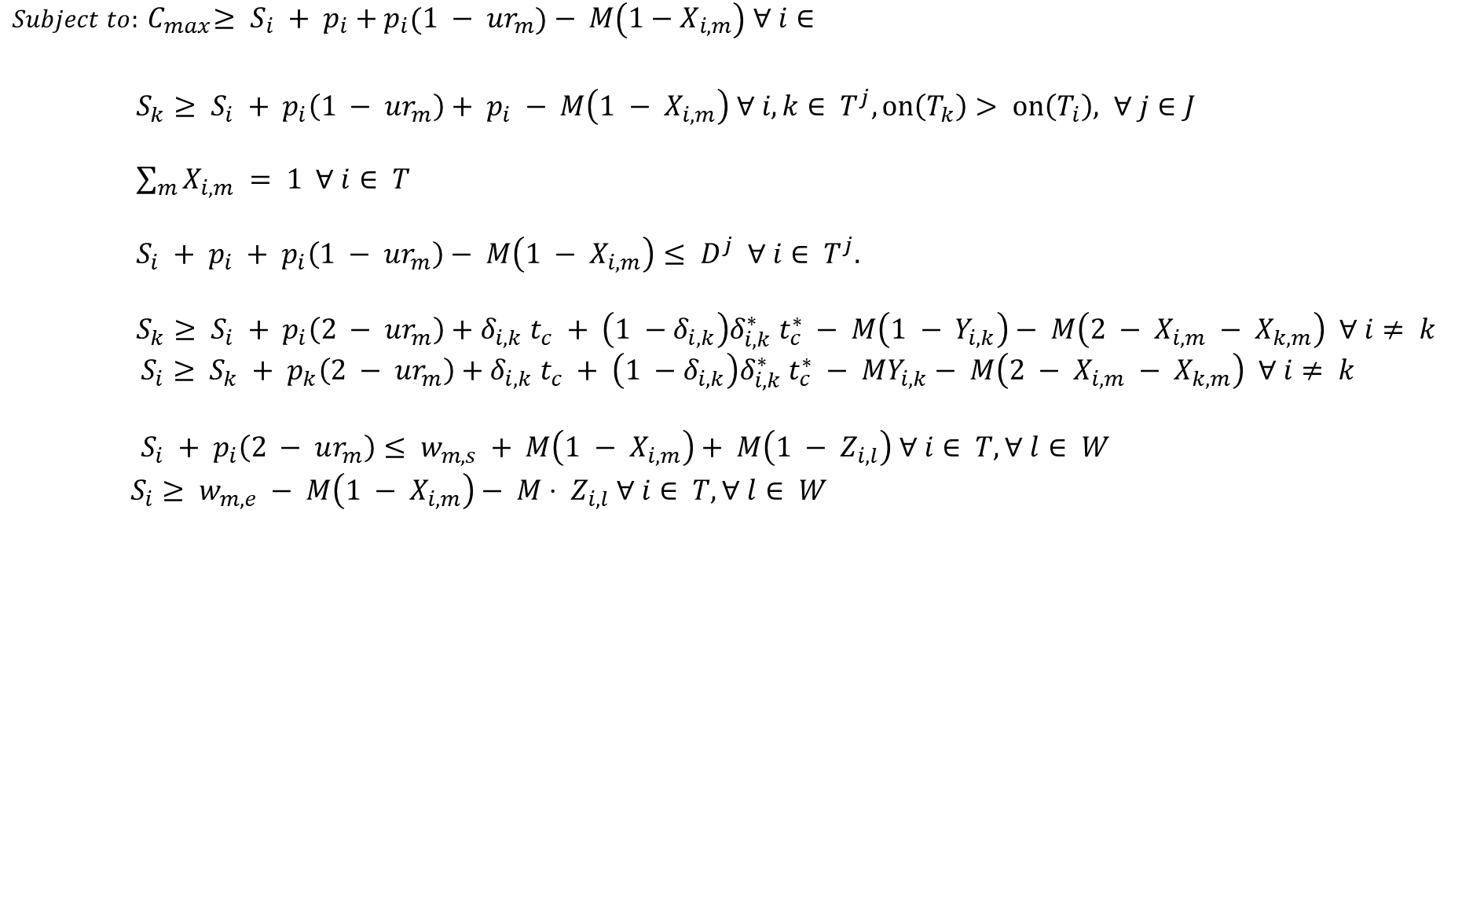

Too many inequality constraints mean too many additional variables.
$$Minimize C_{max}$$
Objective Function
$Subject to:{ C}_{max}≥ S_{i} + p_{i}+p_{i}\left(1 − ur_{m}\right)− M\left(1−X_{i,m}\right) ∀ i∈$
$S_{k}≥ S_{i} + p_{i}\left(1 − ur_{m}\right)+ p_{i} − M\left(1 − X_{i,m}\right) ∀ i,k∈ T^{j}, on\left(T_{k}\right)> on\left(T_{i}\right), ∀ j∈J$
$\sum_{m}{X_{i,m}} = 1 ∀ i∈ T$
$S_{i} + p_{i} + p_{i}\left(1 − ur_{m}\right)− M\left(1 − X_{i,m}\right)≤ D^{j} ∀ i∈ T^{j}.$
$S_{k}≥ S_{i} + p_{i}\left(2 − ur_{m}\right)+δ_{i,k} t_{c} + \left(1 −δ_{i,k}\right)δ_{i,k}^{∗} t_{c}^{∗} − M\left(1 − Y_{i,k}\right)− M\left(2 − X_{i,m} − X_{k,m}\right) ∀ i≠ k$
$S_{i}≥ S_{k} + p_{k}\left(2 − ur_{m}\right)+δ_{i,k} t_{c} + \left(1 −δ_{i,k}\right)δ_{i,k}^{∗} t_{c}^{∗} − MY_{i,k}− M\left(2 − X_{i,m} − X_{k,m}\right) ∀ i≠ k$
$S_{i} + p_{i}\left(2 − ur_{m}\right)≤ w_{m,s} + M\left(1 − X_{i,m}\right)+ M\left(1 − Z_{i,l}\right) ∀ i∈ T, ∀ l∈ W$
$S_{i}≥ w_{m,e} − M\left(1 − X_{i,m}\right)− M⋅ Z_{i,l} ∀ i∈ T, ∀ l∈ W$
Task Order Constraint
Single Machine Assignment
Need by Date Constraint
No machine overlapping/ Campaigning
Maintenance/ Holidays

Slide 8

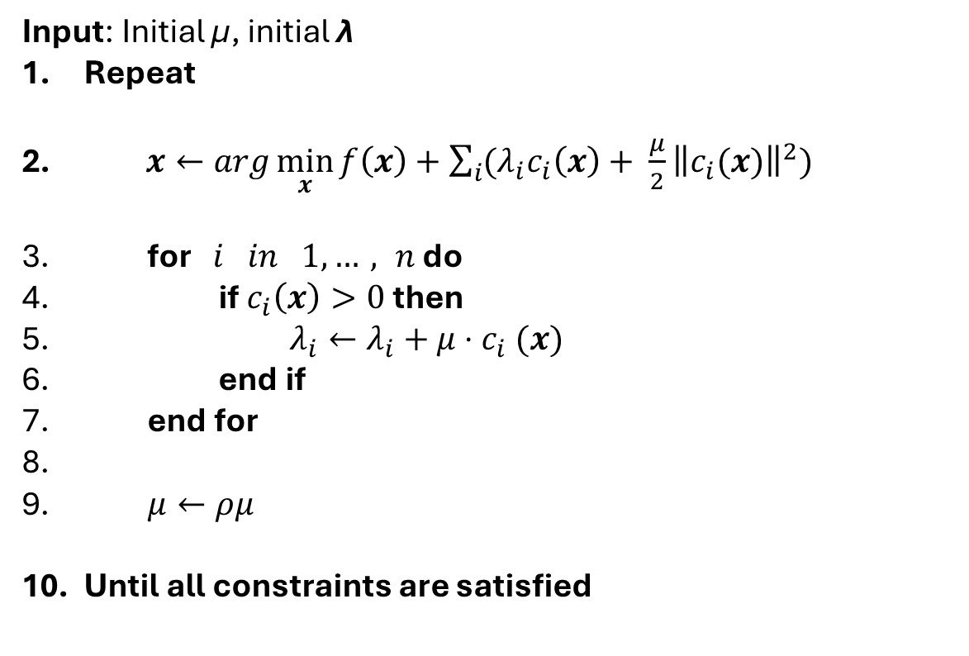
Augmented Lagrangian Method
$$c\left(x\right)≔a^{T}x −b$$
Input: Initial μ, initial λ
Repeat
$x←arg\min_{x}{f\left(x\right)+\sum_{i}{{(λ}_{i}c_{i}\left(x\right)+ \frac{μ}{2}{\left\|c_{i}(x)\right\|}^{2})}}$
for $i in 1,…, n$ do
if $c_{i}\left(x\right)>0$then
$λ_{i}←λ_{i}+μ{⋅c}_{i}(x)$
end if
end for
$μ←ρμ$
Until all constraints are satisfied
Solve using a quantum algorithm
If Constraint is violated
Increase the penalty

Slide 9
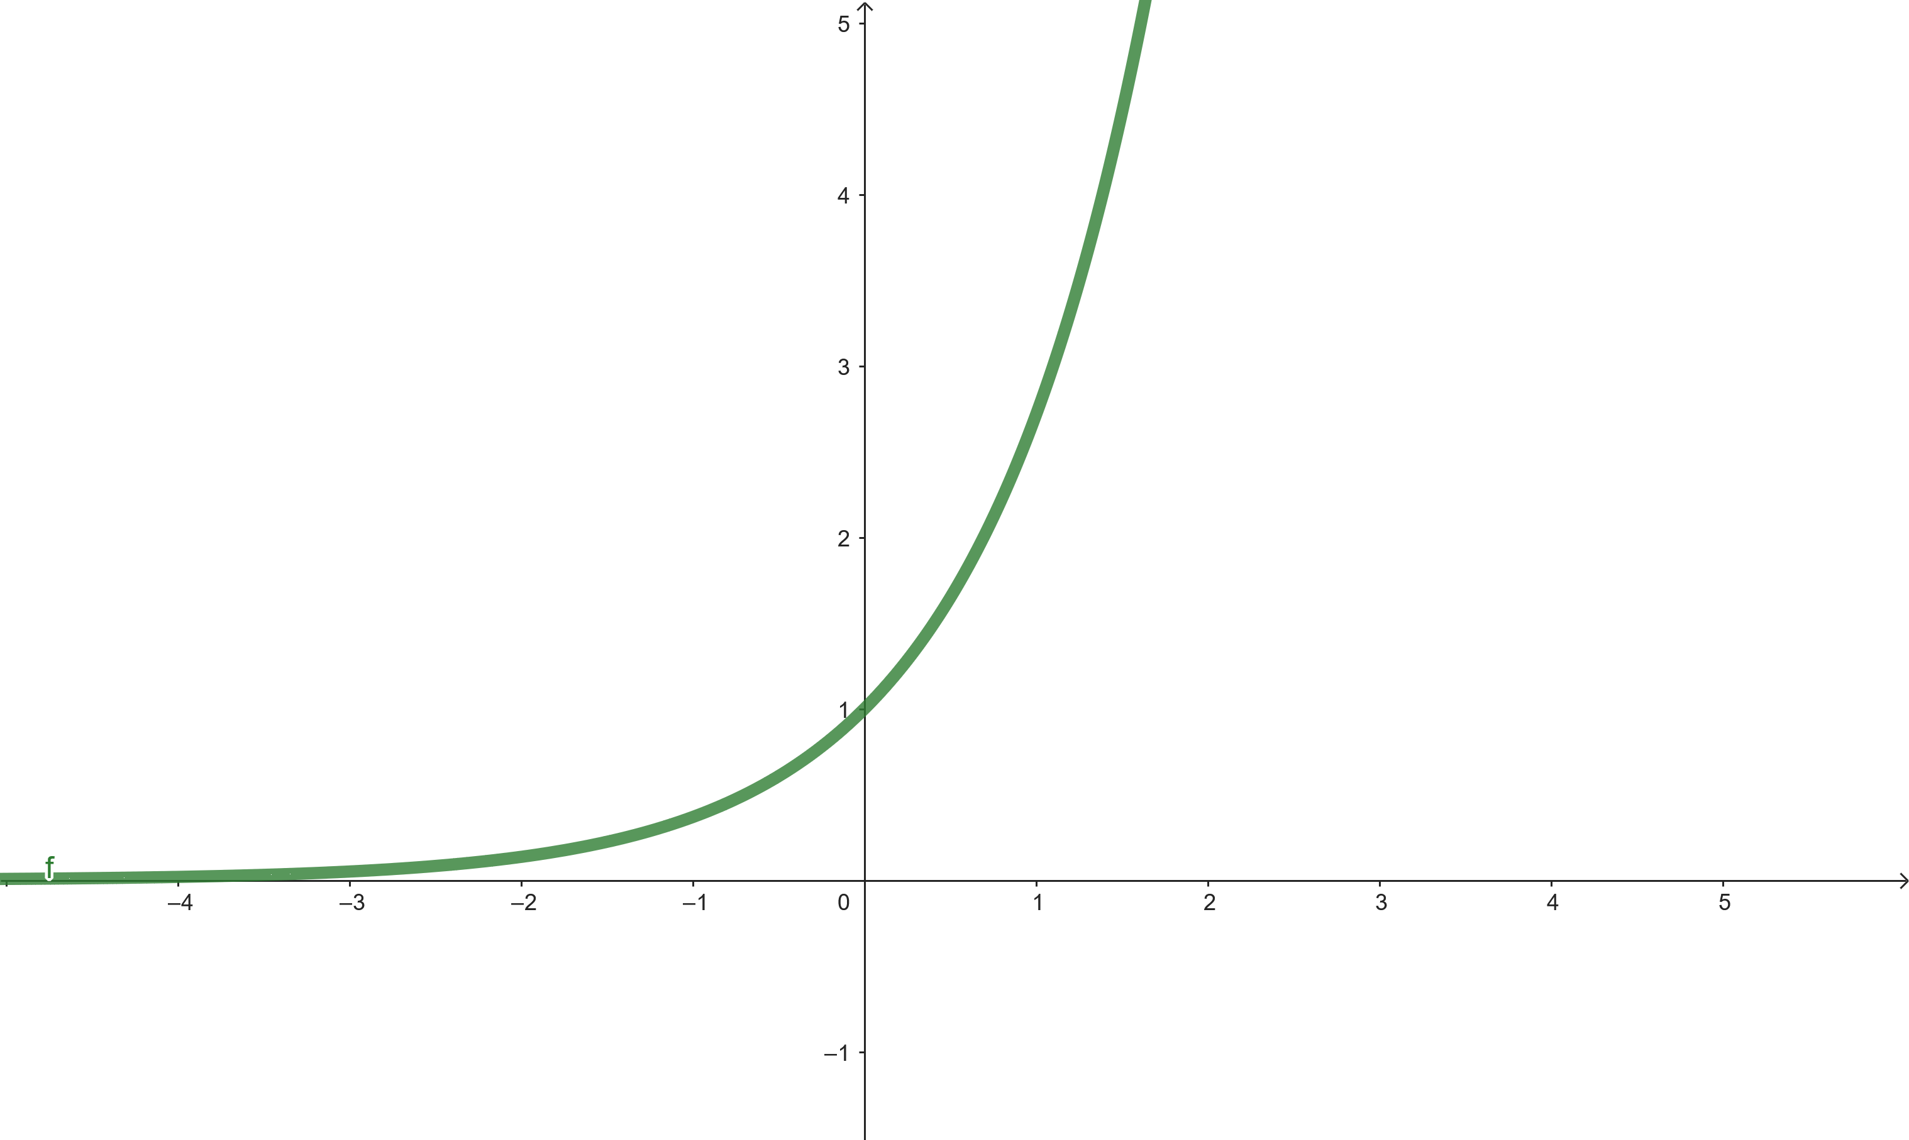
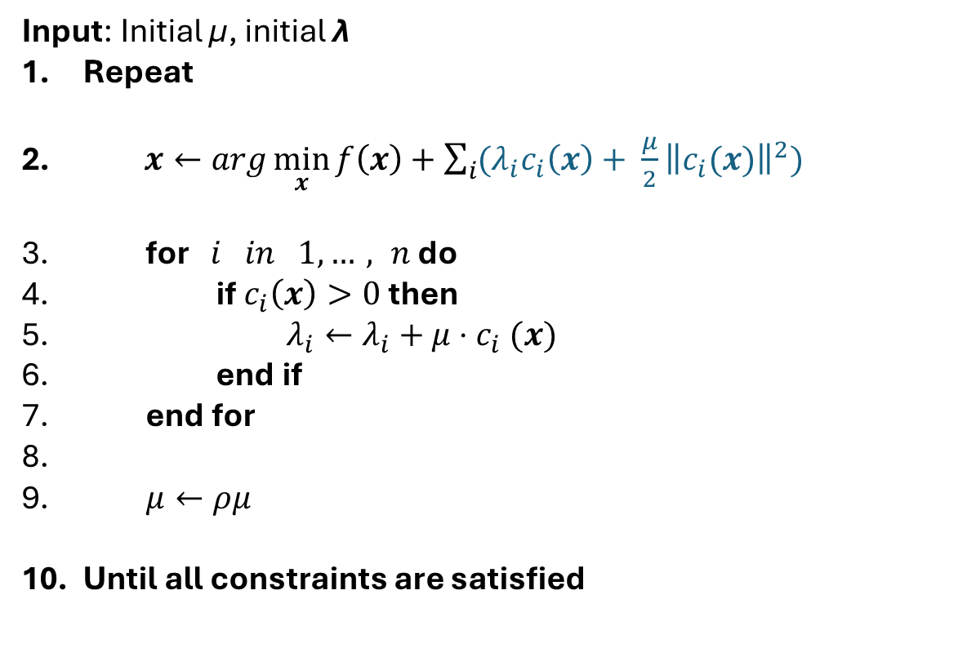
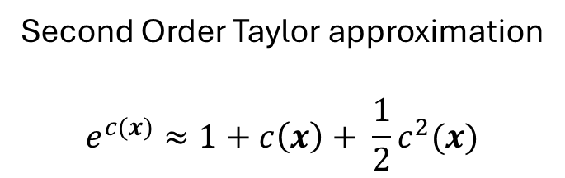
Augmented Lagrangian Method
Second Order Taylor approximation
$$e^{c(x)}≈1+c\left(x\right)+ \frac{1}{2}c^{2}(x)$$
$$c\left(x\right)≔a^{T}x −b$$
Input: Initial μ, initial λ
Repeat
$x←arg\min_{x}{f\left(x\right)+\sum_{i}{{(λ}_{i}c_{i}\left(x\right)+ \frac{μ}{2}{\left\|c_{i}(x)\right\|}^{2})}}$
for $i in 1,…, n$ do
if $c_{i}\left(x\right)>0$then
$λ_{i}←λ_{i}+μ{⋅c}_{i}(x)$
end if
end for
$μ←ρμ$
Until all constraints are satisfied
Solve using a quantum algorithm
If Constraint is violated
Increase the penalty

Slide 10
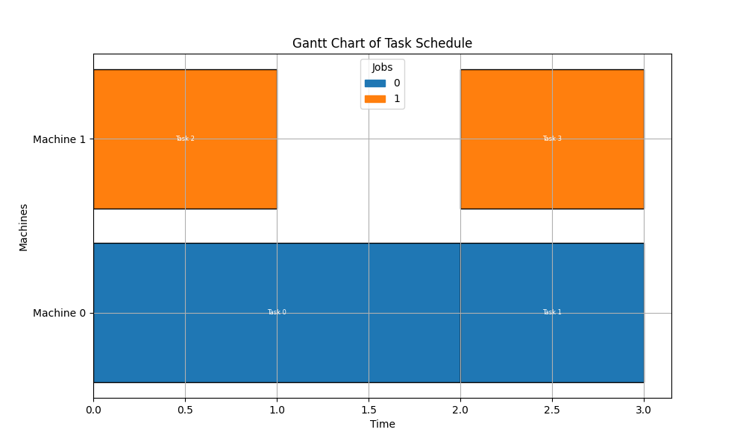




Results from our example.
Machine 1
ID 1 |  | ID 2
ID 3 | ID 4
Machine 2
$$t_{1}$$
$$t_{2}$$
$$t_{3}$$
$$t_{4}$$
Solved in 4 iterations

